Slide 1
Building Netflix/Hotstar at low cost using AI
Anil Chandra Naidu Matcha, Vadoo
@matchaman11

Slide 2
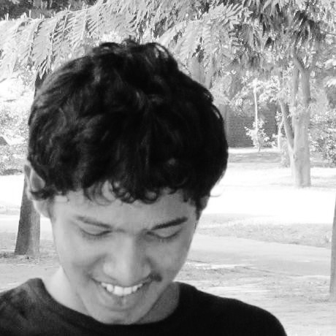
SPEAKER
Co-Founder at Vadoo building SAAS platform to scale video streaming
Previously AI engineer at Samsung, Cisco
IIT Delhi graduate
Instructor at Upgrad, GreatLearning, BoardInfinity and TheValleyBootcamp
Technical Author at Paperspace, Nanonets, Fritz AI

Slide 3
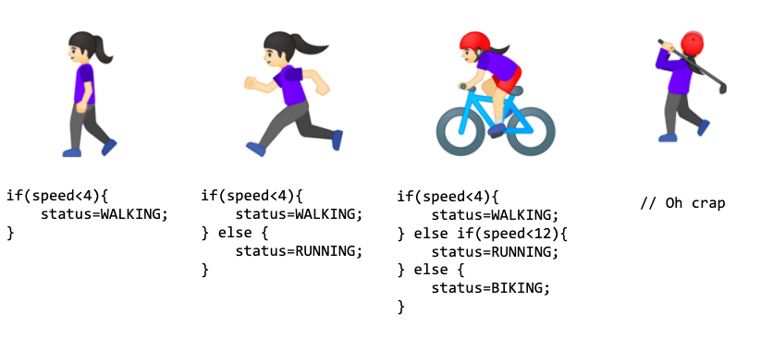
Machine Learning

Slide 4
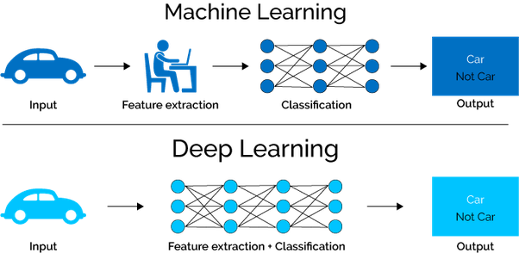
Deep Learning

Slide 5
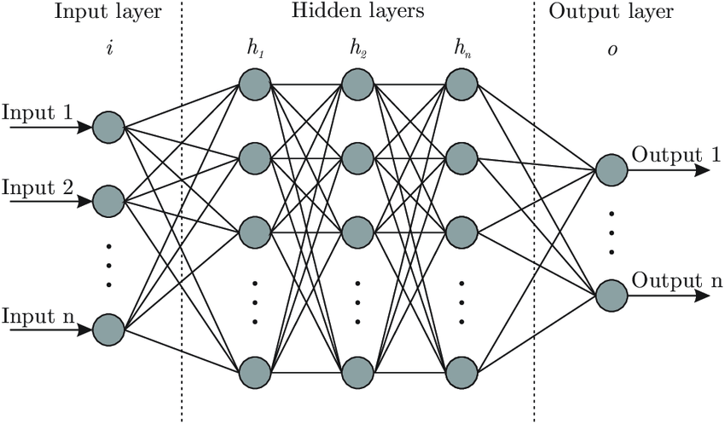
Neural Network

Slide 6
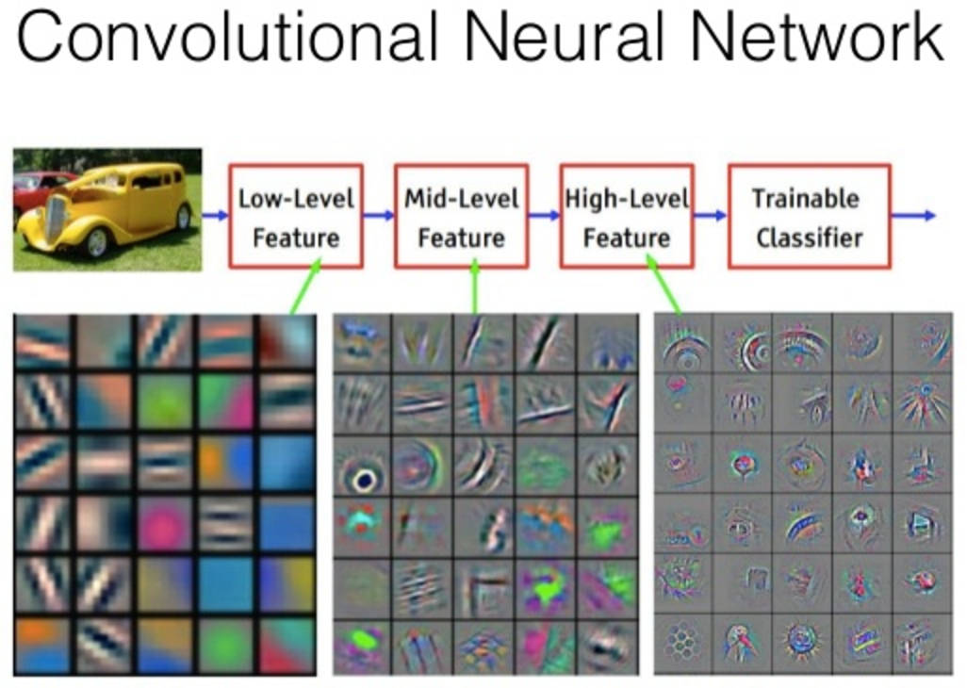
Intro to CNN

Slide 7
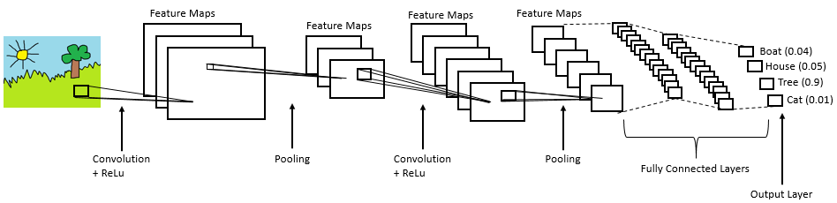
CNN architecture

Slide 8
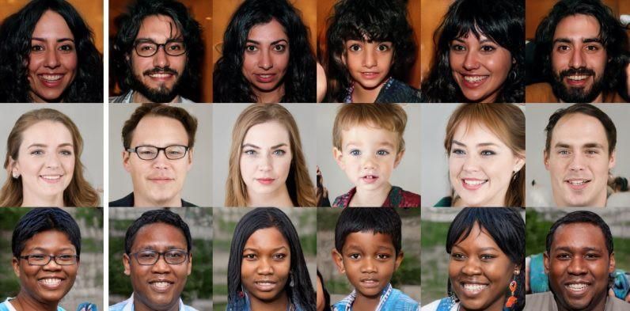
Generative algorithms

Slide 9
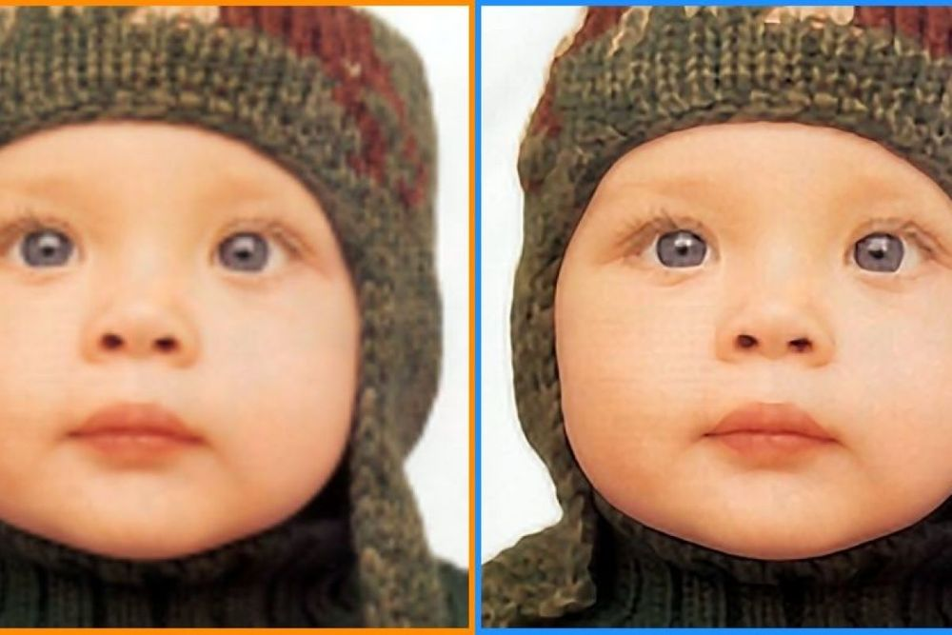
Intro to Super-Resolution

Slide 10
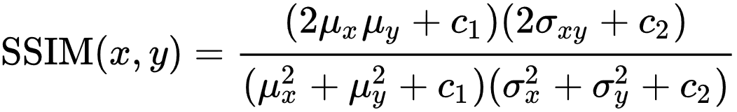
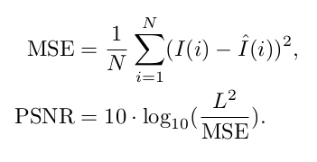
Metrics

Slide 11
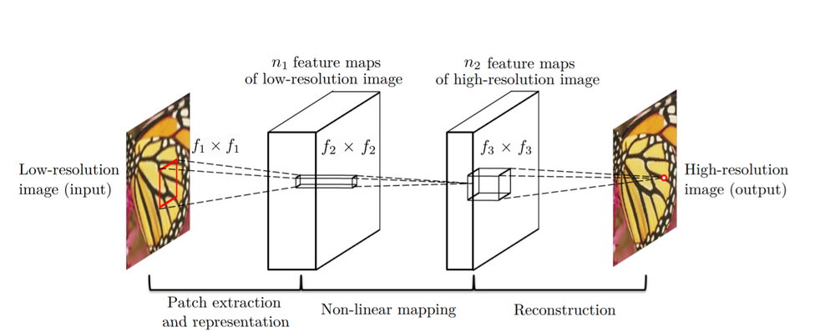
Architectures

Slide 12
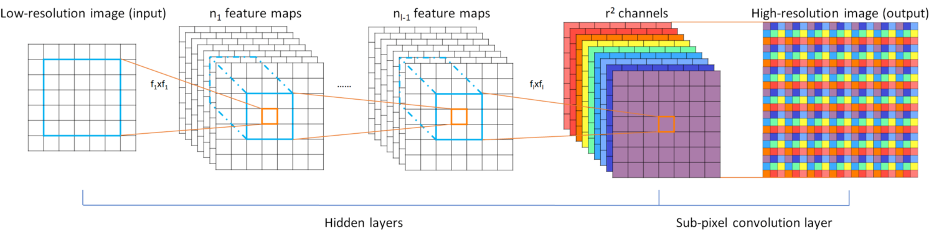
ESPCN

Slide 13
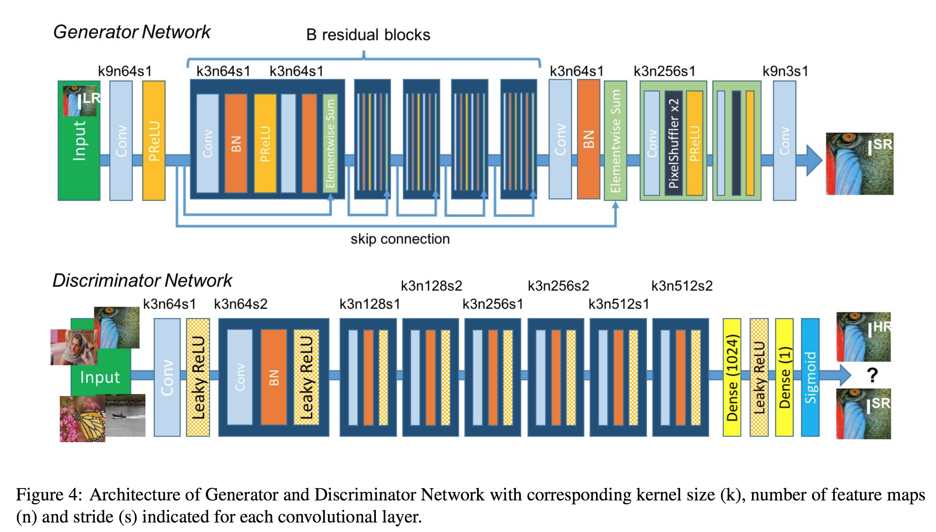
SRGAN

Slide 14
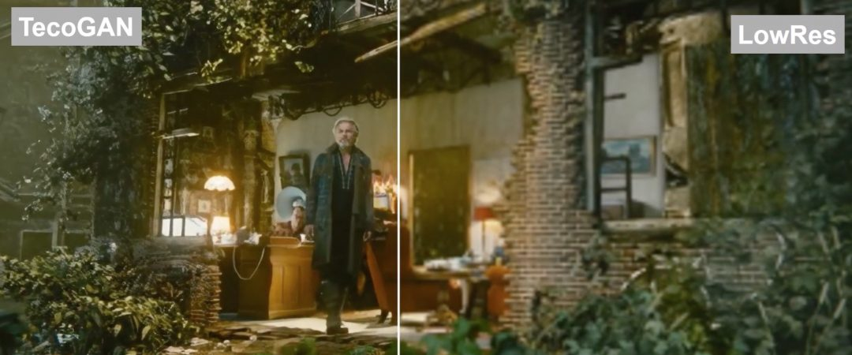
Video Super-Resolution

Slide 15
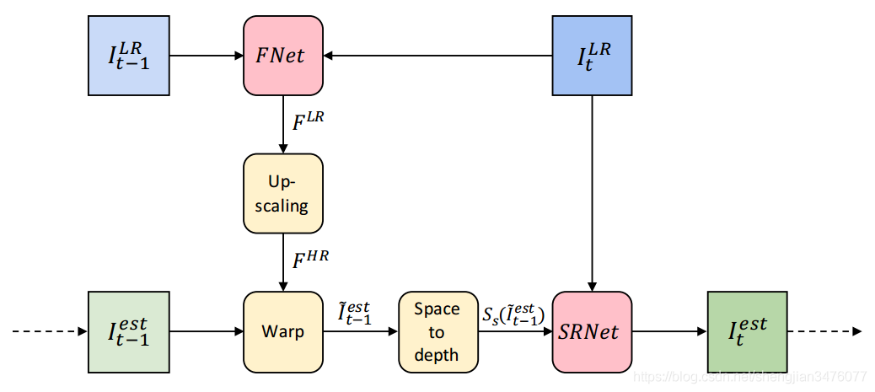
FRVSR

Slide 16
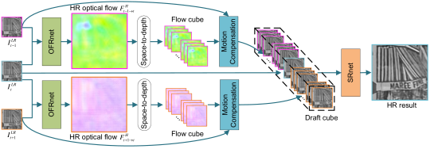
OFRNet

Slide 17
Q & A
Contact
Linkedin :- https://www.linkedin.com/in/anilmatcha/
Twitter :- https://twitter.com/matchaman11

